Slide 1
CAR Champion Calibration Meeting CAR Review
Team “C”
Ronald Tse (CAR 163916470 Finding)
Thomas Kestner (CAR 163916513 Observation)
Balina Ling (CAR 163916189 Finding)
Balina Ling (Exemplary CAR 163916077 Finding)

Slide 2
CAR 163916077 Finding
Presented by Balina Ling

Slide 3
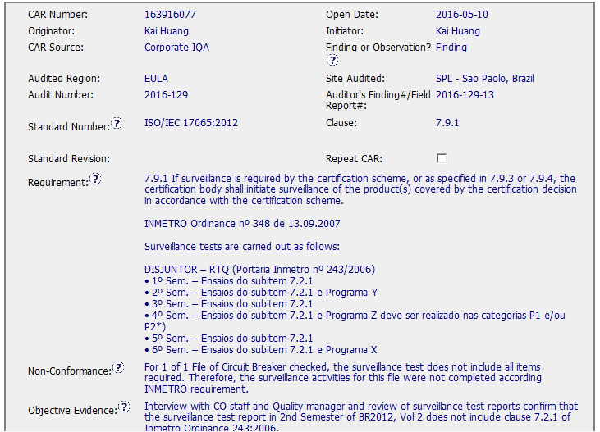
CAR 163916077
Finding - CAR
Background: Corp IQA- “Surveillance test does not include all items required.”

Slide 4
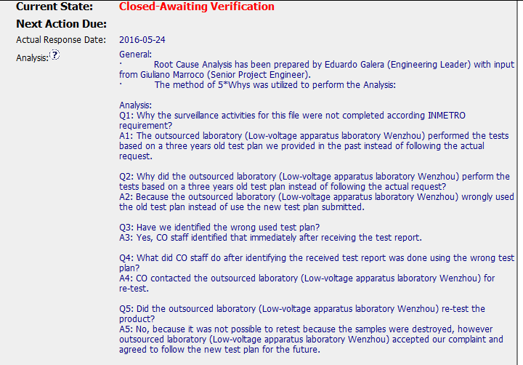

CAR 163916077 Analysis
Excellent (1)
Analysis:
stakeholders identified; used 5 whys to perform analysis, it shows clear path to root cause and scope.
Excellent (2)
Root cause statement is succinct, reasonable, complete and naturally flows from the analysis.

Slide 5
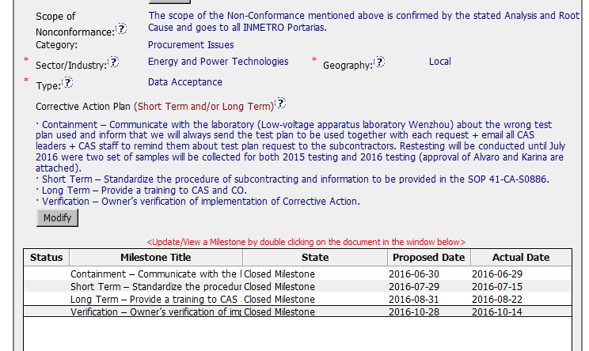
CAR 163916077 Corrective Action
Excellent (3)
Corrective action plans fix nonconformance and root cause

Slide 6
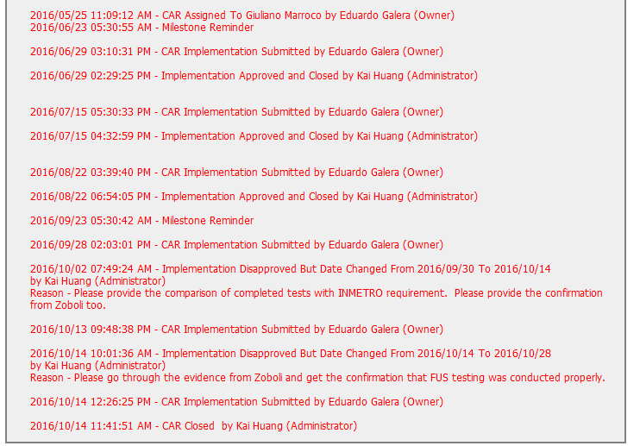
CAR 163916077 History Summary
Excellent (4)
Extension are within requirement (< 30 days)
2) Act on CAR in required timeframe

Slide 7
CAR 163916077 – CBS Check
CBS Requirements | Excellent | Moderate | Need Improve | N/A
(C) Extensions are within requirement (<30 days, 3 or less) | √
(T) Most appropriate ‘category’, ‘type’, ‘geography’ are selected | √
(P) Facilitates the handling of disputed CARs |  |  |  | √
(T) Acts on CARs within required timeframe | √
(C) Analysis shows clear path to root cause and scope; stakeholders identified | √
(C) Root cause statement is succinct, reasonable, complete (Shows ‘N/A’ for observations) | √
(C) Corrective actions fix the objective evidence and other problems found; address entire root cause and scope. For observations, they do not go beyond fixing the objective evidence | √
(C) Milestones address containment & owner’s verification; completed per milestone expectations | √
(P) Verification per requirements | √
(L) Referenced communications are attached as needed | √
(C L) Evidence of communication for overdue/escalated CARs and other pertinent concerns |  |  |  | √
(P) Trains other CAR Champions |  |  |  | √

